Slide 1
LC/ESI-MS Peptide Identification
Matthew Bellew
mbellew@fhcrc.org
http://edi.fhcrc.org/
STEDI
software tools for the early detection initiative
McIntosh Informatics Lab

Slide 2
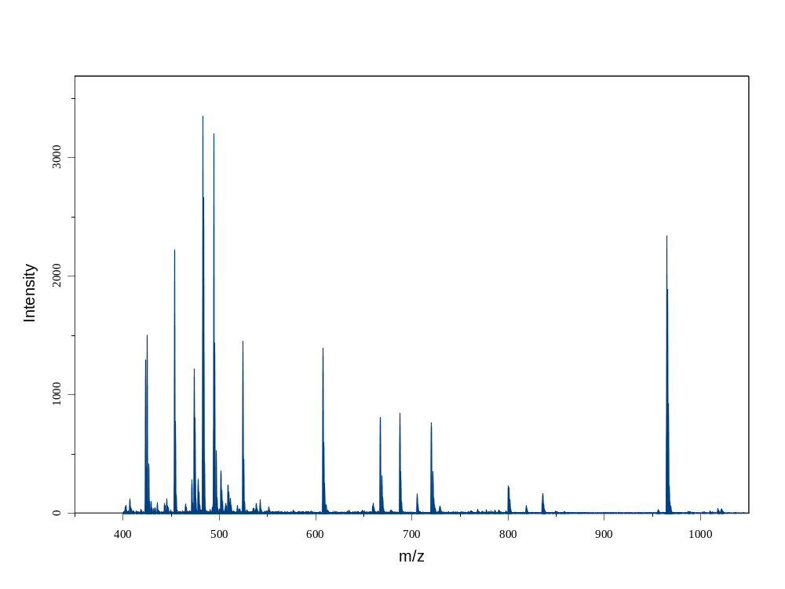
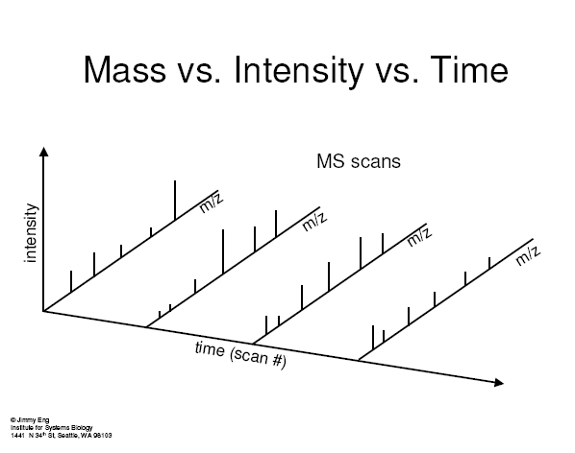
LC/ESI-TOF MS in a nutshell
LC: Liquid chromatography:
  A procedure for predictably delivering proteins over time to an MS system.
ESI (electro spray ionization):
  Turns proteins in liquid into charged gas-phase ions.
TOF (time of flight) mass spec:
  Charged detector at end of pipe.
  Estimates mass to charge ratio (mz) of ions by their time of flight.
  Estimates abundance by total ion current.

Slide 3
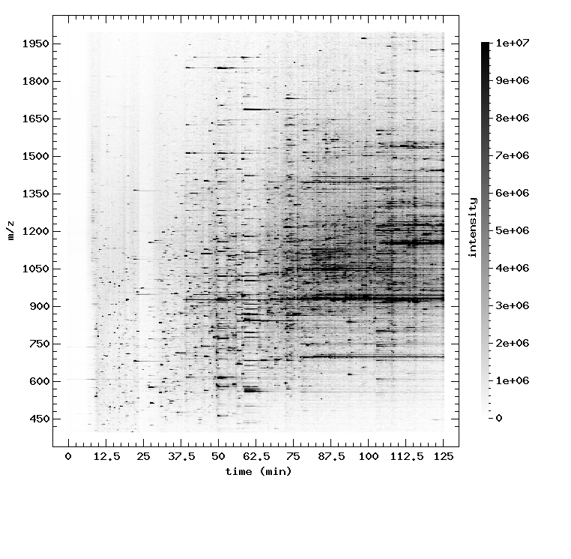
Basic approach to ESI-TOF Biomarker Discovery
Two groups of samples; identify peptides/proteins that differentiate the groups.
In spirit similar to SELDI/MADLI classification
approach, but can facilitate its identification.

Slide 4
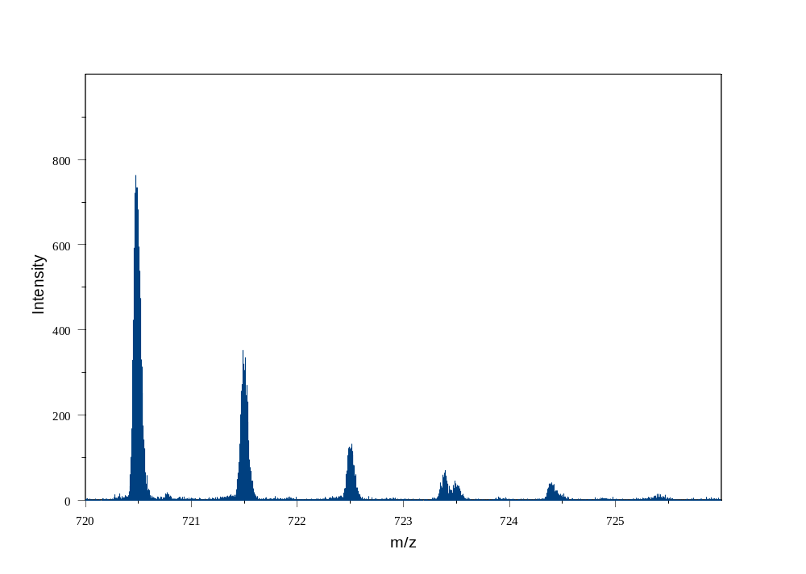
Isotopes in TOF-MS
Mono-isotopic molecular weight: Always the first in the distribution
Average MW

Slide 5
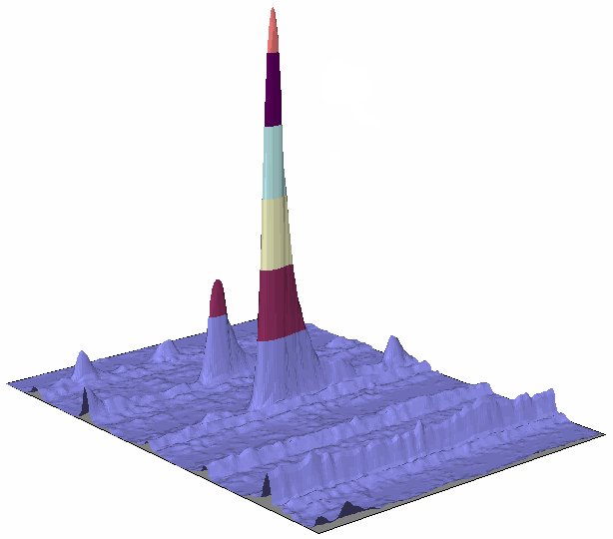
Quark’s Eye View
peptide
?
chemical noise
?
mz
time
Notes:
10DaMin

Slide 6
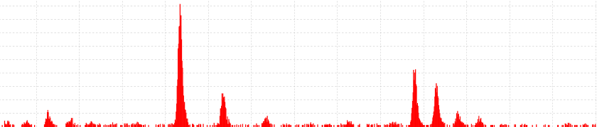
Basic Approach
For each scan
Step 1 – Find Peaks (location,size)
Step 2 – Extract Features
  Find biggest peak
  Find feature (peptide) that contains this peak
  Repeat
Aggregate repeated features
  Each peptide is scanned multiple times
Feature 1
Feature 2
Feature 3

Slide 7
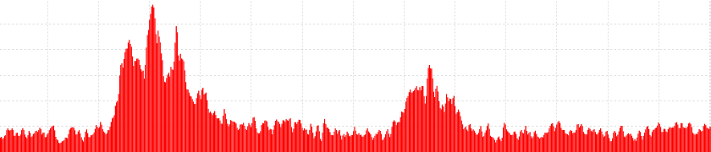

Find Peaks
Goodness is one algorithm that performs well for many MS platforms
Notes:
This is where we start talking about actually analyzing the MS data.
This slide is a reminder that not all high-resolution MS machines are the same.
Mass Spec machines vary in resolution and peak width.
Ion sources may give you a different mix of charge states
LC pumps seem to have bad days.
NOTE: each slide has the same MZ scale

Slide 8
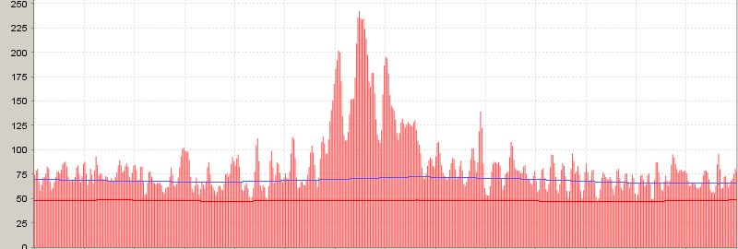
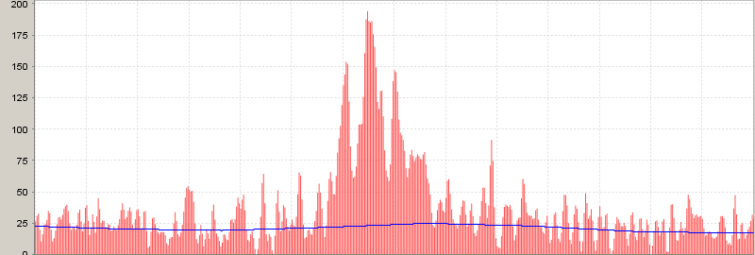
Find Peaks (size)
Remove Background using sliding percentile filter
Increases contrast
Improves comparability of peaks in areas of different background levels
Report background level for filtering
240
100
180
50

Slide 9
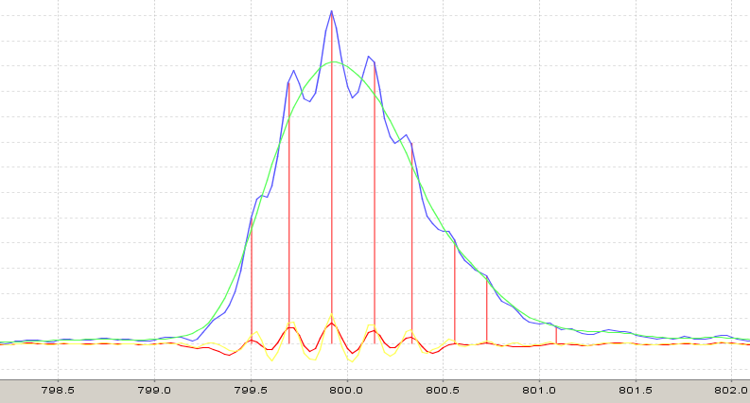
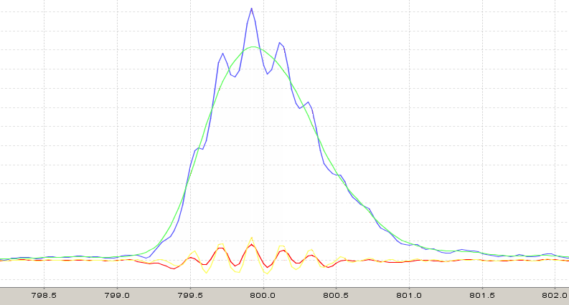
Find peaks (location)
Peaks for highly charged ions overlap
Tim Randolph inspired approach
The signal we care about has specific characteristic width (1Da/maxcharge)
Wider or smoother changes are “background”
Narrower changes are “noise”
Compared to smooth/maxima approach, does not require fussy tuning

Slide 10
Extract Features
Evenly spaced peaks (1Da/charge)
We model peak intensities as Poisson distribution (µ=mass * 0.00049)
Distribution helps us determine first peak of a feature and untangle overlapping features
Kullback-Leibler measures between observed and expected signal
0.2Da spacing
Nice Poisson shape
Perfect 5+ peptide
?

Slide 11
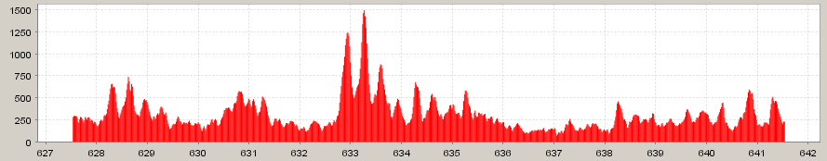
Basic Approach Review
Analyze each scan
  Step 1 – Find Peaks (location,size)
  Step 2 – Extract Features
    Find biggest peak
    Find feature (peptide) that contains this peak
    Repeat
Aggregate repeated features
The better the peaks, the better this works
  Remove background
  Wavelet analysis
  Isotopic distribution
Notes:
DEMO tool
Ovarian10e (scan 760, mz 634)

Slide 12
Aggregate Features
Features persist over multiple scans
  This increases confidence in correct identifications
Doesn’t improve initial identification
Signal/noise can be low
Averaging/Smoothing across spectra helps (reduces high-frequency noise), but…
Leading/trailing edges of elution still look like noise
Notes:
DEMO tool
Ovarian10e (scan 760, mz 634)

Slide 13
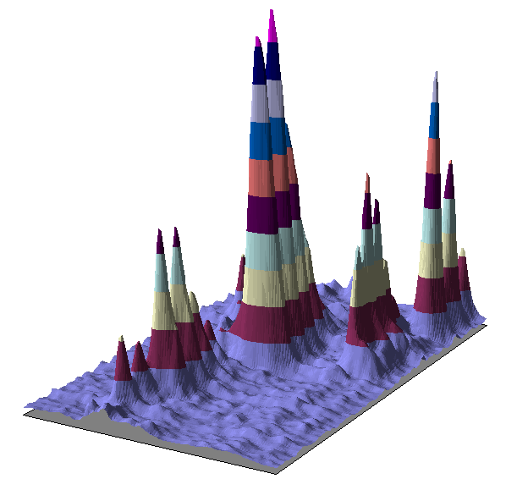
Complex sample…
mz
time

Slide 14
New Approach
Find peaks in 2D
  mz and time: start, max, end
Persistence of individual peaks and of coincident peaks, raises confidence in identification
Allows very high sensitivity
Separate the peaks into groups
Extract features much as before

Slide 15
Algorithm
Find Peaks
  Remove background (2D remove streaks as well)
  Process scans with wavelet analysis (same)
  Find all local maxima (in 2D, of course)
  For each maxima, find where the peak starts and ends (above minimal threshold)
  Throw out short features (endscan-startscan)
  Throw out peaks not coincident with other peaks
Extract features from groups of related peaks

Slide 16
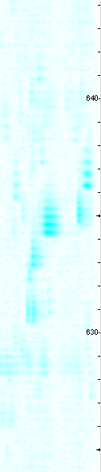
Complex sample…
mz
time

Slide 17
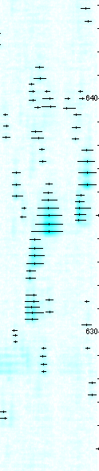
Find Peaks
mz
time

Slide 18
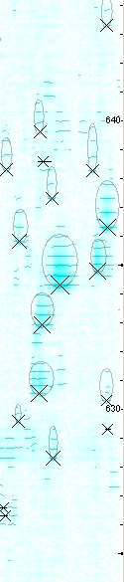

Extract Features
mz
time

Slide 19
Big peaks are boring
Interesting features are probably small
Identify small features with low false positive rate
Increase confidence in feature identification
  Sensitive peak detection (wavelet)
  Persistence of peaks
  Coincidence of peaks (shape, location)
  Isotopic distribution

Slide 20
Future Investigation
Local optimization of feature groups (avoid pitfalls of greedy extract feature algorithm)
Other scoring/quality functions
Global optimization (multiple charge states)
Alignment, should we be using peaks or features
  confidence in peak existence can be higher than our confidence of feature charge/mass identification

Slide 21
Acknowledgements
Martin McIntosh – advisor
Tim Randolph – algorithm development
Mark Igra – alignment, viewer features
Pei Wang, Mark Coram, ChenWei Lin – quality analysis/validation
Dawn Kinsey – user, tester, analyst

Slide 22
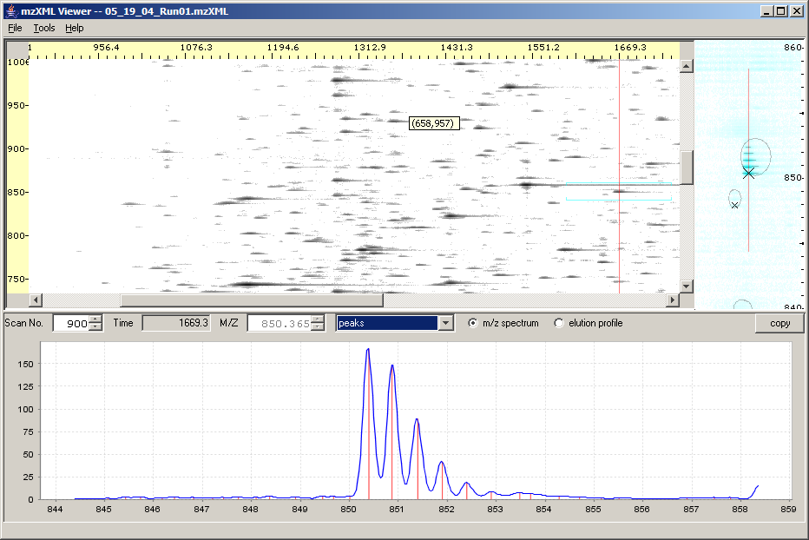
MS1 Viewer http://edi.fhcrc.org/
Notes:
The first problem we had was just being able to look at the data in a 4Gb file.
When we got the first data off the machine we were writing perl scripts to extract spectrum to view in R
So if you don’t believe anything else I show you today, I think many of you may find this tool useful just as a way to explore your data.

Slide 23
END

Slide 24
BDI
Comparative Proteomics
  Profile complex serum/tissue samples with high resolution MS
  Extract “features”
  Compare cases/controls
MS Data
  Online HPLC
  Sequentially scanned MS spectra
  Approx 1 scan/sec
  High resolution data >100 samples/Da
  Typical datasets 500Mb – 4Gb

Slide 25
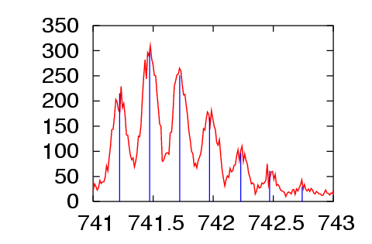
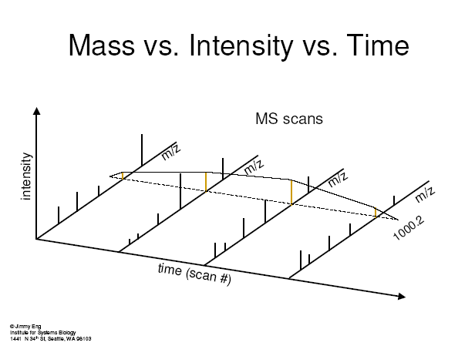
Information we should be able to use when detecting features
Peptides have predictable isotopic distributional shape.
Peptides elute in predictable shape (most of the time).
I₁
I₂
I₀
I₃
I₄

Slide 26
Example of single TOF scan

